Slide 1
Generative Adverarial Nets

Slide 2
Why Generative Models?
Realistic samples for artwork, super-resolution, colorization, etc.
Generative models of time-series data can be used for simulation and planning (reinforcement learning applications!).
Training generative models can also enable inference of latent representations that can be useful as general features

Slide 3
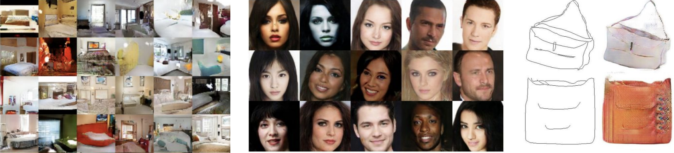
Why Generative Models?

Slide 4
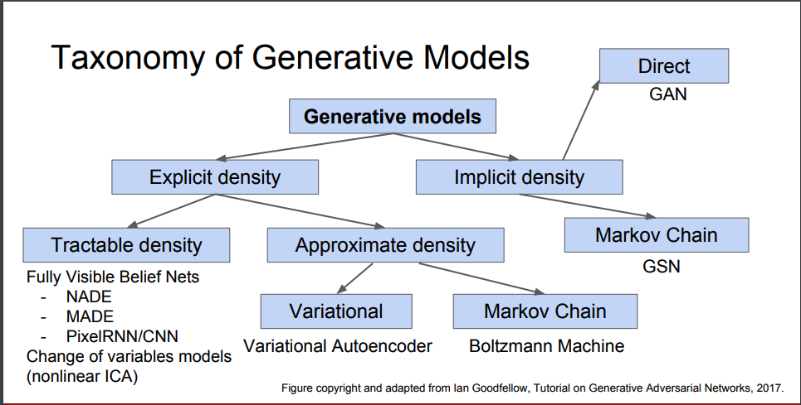

Slide 5
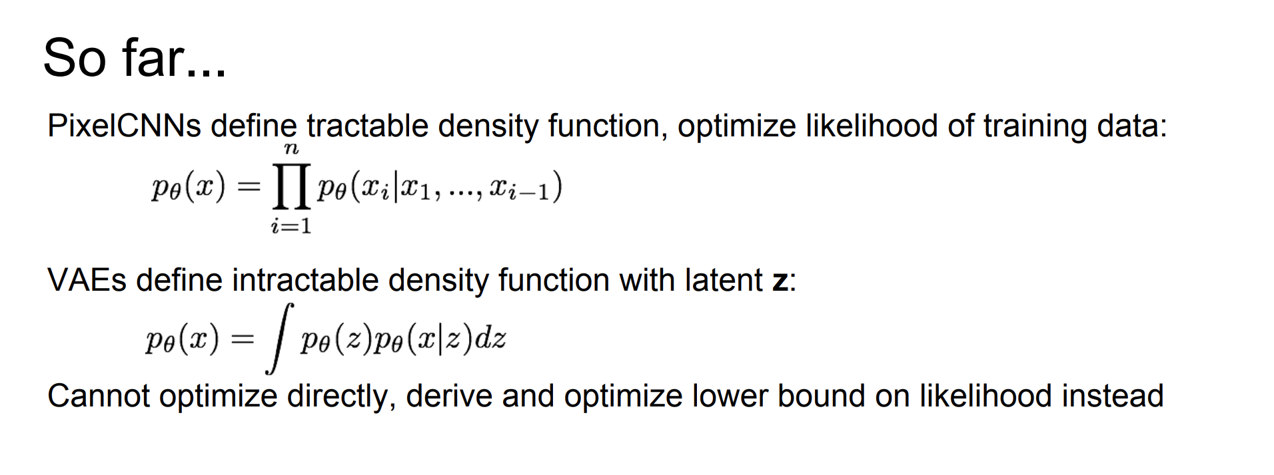

Slide 6
 | PixelRNN/PixelCNN | VAE | GAN
Pros | Explicit likelihood of training data gives good evaluation metric Good samples | Principled approach to generative models Feature representation for other tasks | Beautiful, state-of-the-art samples!
Cons | Sequential generation => slow | Maximizes lower bound of likelihood: okay, but not as good evaluation Samples blurrier and lower quality compared to state-of-the-art (GANs) | Trickier / more unstable to train Can’t solve inference queries

Slide 7
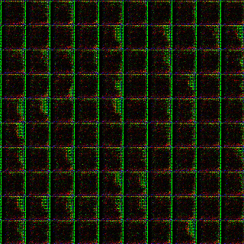

Slide 8
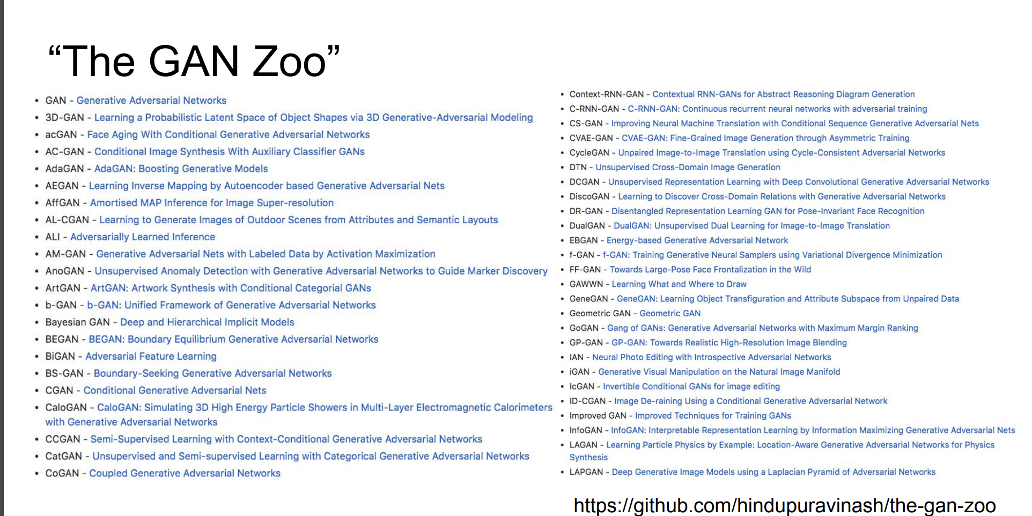

Slide 9
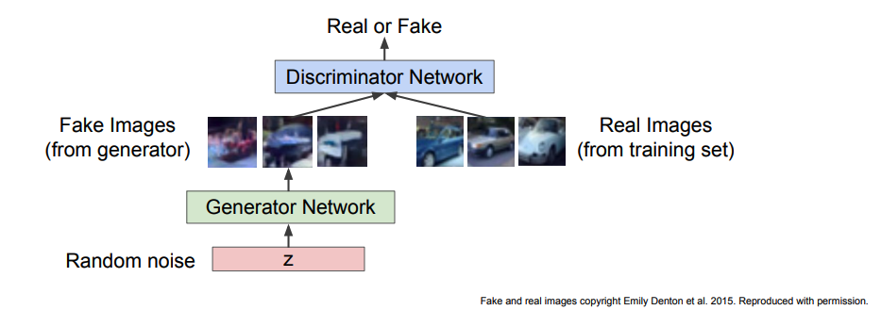
Training GANs: Two-player game

Slide 10
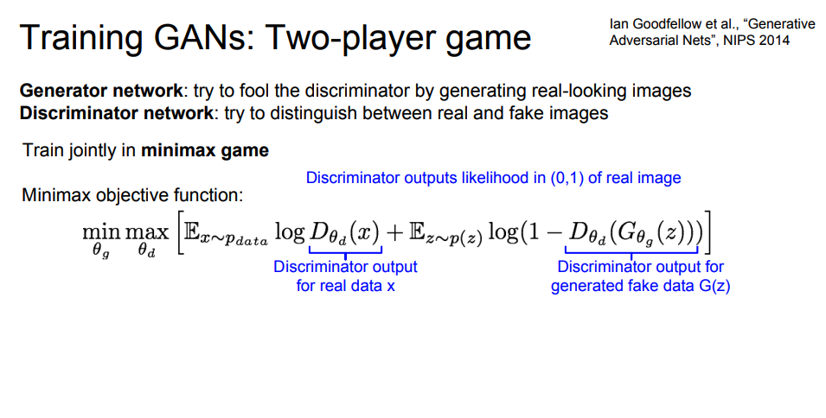
GANs Objective Function

Slide 11
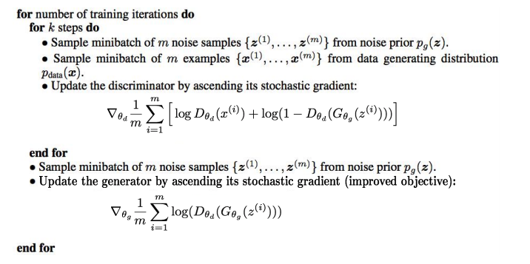
How to train GANs

Slide 12
Why is training GAN so hard?
Non-convergence
Optimization algorithms often approach a saddle point or local minimum rather than a global minimum
Game solving algorithms may not approach an equilibrium at all

Slide 13
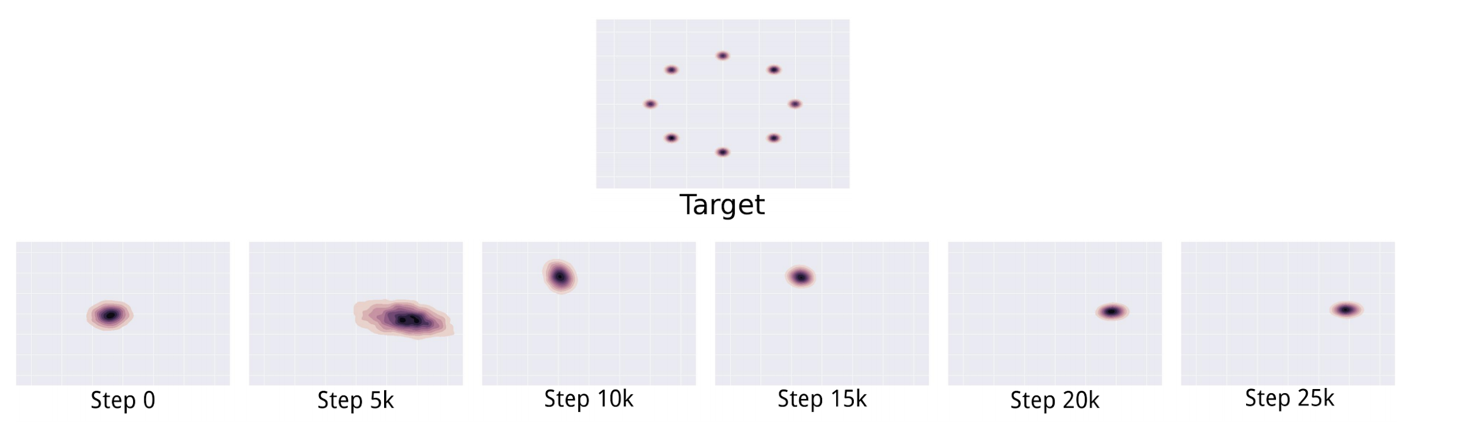
Why is training GAN so hard?
Mode Collapse

Slide 14
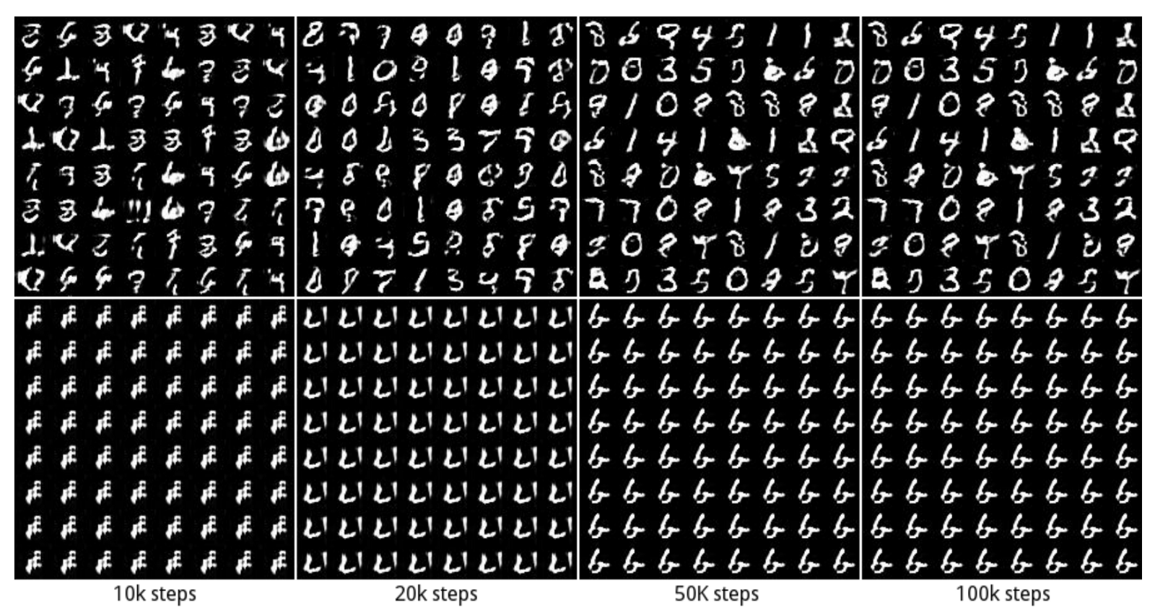

Slide 15
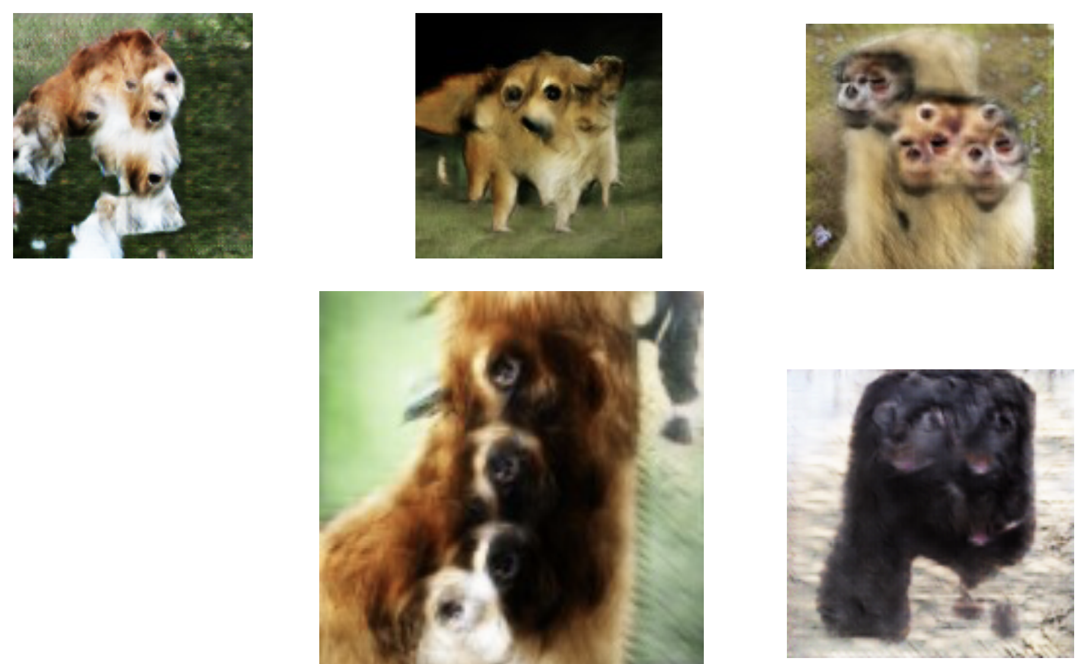
Why is training GAN so hard?
Problems with Counting

Slide 16
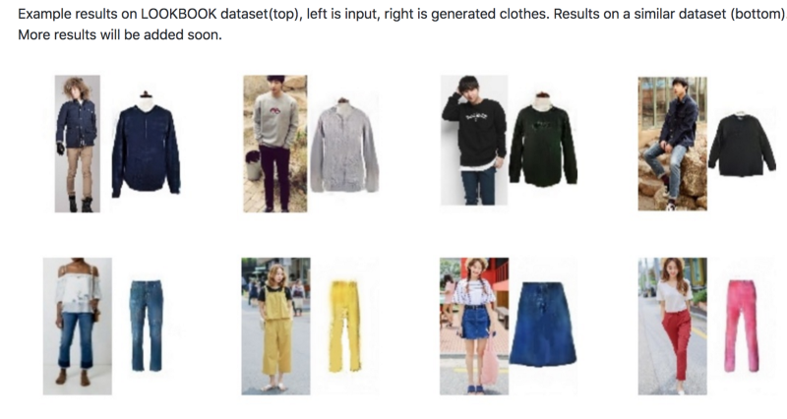
More Applications: Pixel DT GAN
https://arxiv.org/pdf/1711.02231.pdf

Slide 17
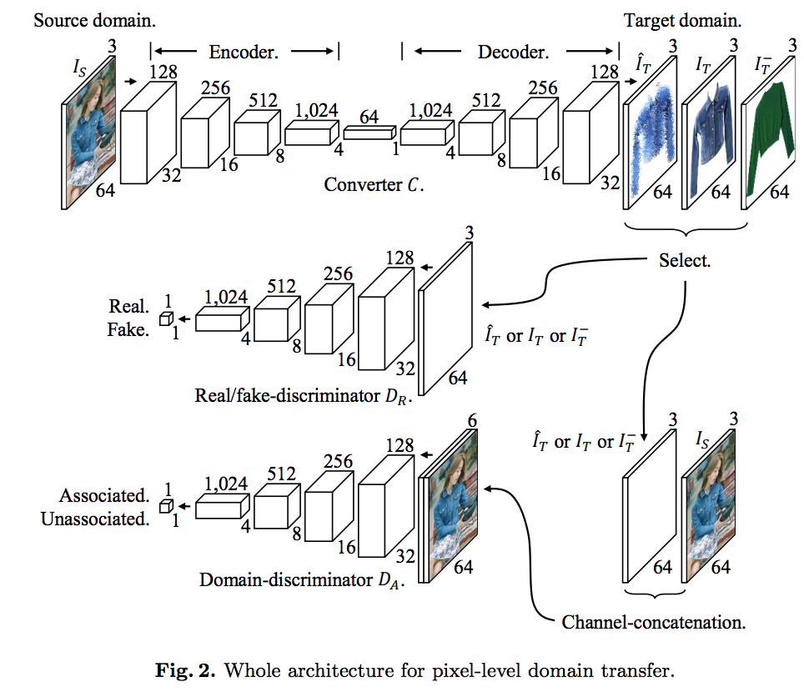

Slide 18
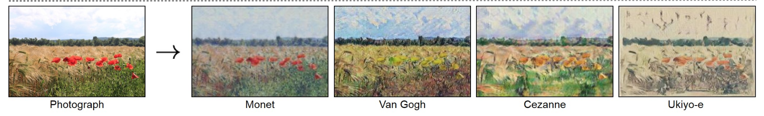
CycleGAN

Slide 19


Slide 20
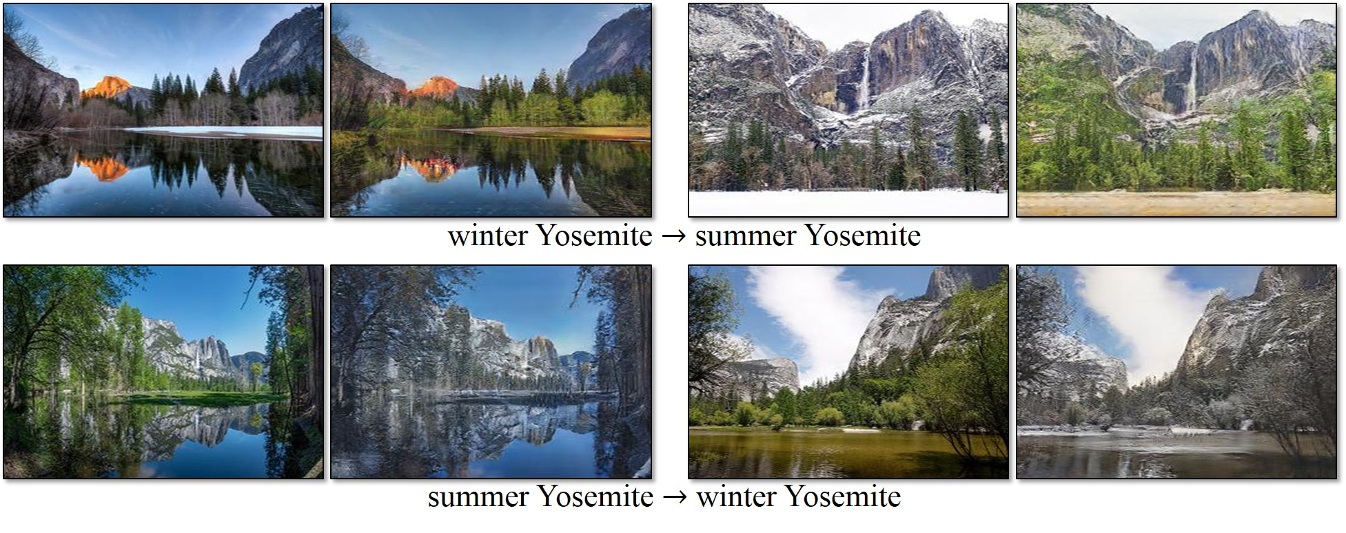
Style transfer

Slide 21
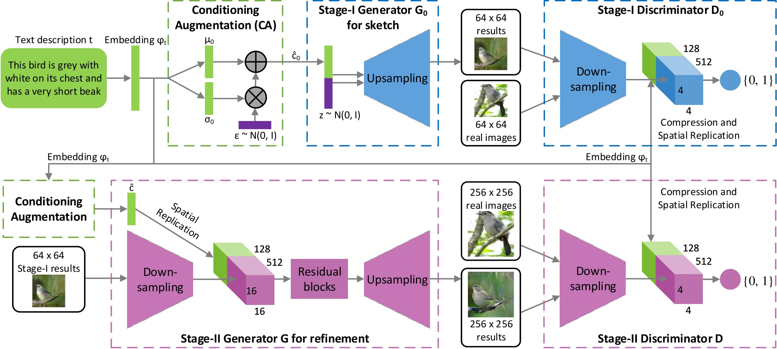
StackGAN
https://arxiv.org/pdf/1612.03242v1.pdf

